Slide 1
ETL Project
Gina Cameras, Abby Ko, Wendy Meyer, Veronica Ratcliff
Data Analytics Bootcamp - April 28, 2020
Notes:
Veronica

Slide 2
Extract | Data Sources
Hate Crime
National: The United States Department of Justice
https://crime-data-explorer.fr.cloud.gov/downloads-and-docs
Years: 1991-2018
Austin: The City Of Austin
https://data.austintexas.gov/browse?q=hate%20crime&sortBy=relevance
Years: 2017-2018
Notes:
Veronica
According to the FBI’s Crime Data Explorer, the Hate Crime datasets provide annual statistics on the number of incidents, offenses, victims, offenders, locations that are motivated by the offender’s bias against the victim’s perceived race, gender, religion, disability, ethnicity, or sexual orientation.

Slide 3
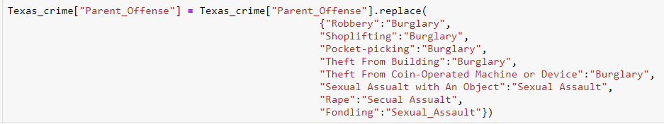

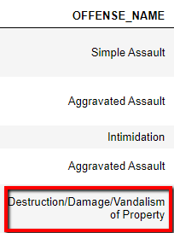
Data Transformation
National (Single CSV)
Selected necessary columns
Filtered down to state of Texas
Re-named columns
Broke out offense column into 2 to view parent offense
Simplified parent_offense column by aggregating like offenses
Extracted day of week, month, day from reported date
Austin (Two CSVs)
Merged 2017 and 2018 datasets
Re-named columns
Formatted date (added “/” to 2018 data)
Extracted day of week, month, day from reported date
Aggregated bucketed offender and victim columns to get single total
Notes:
Gina

Slide 4
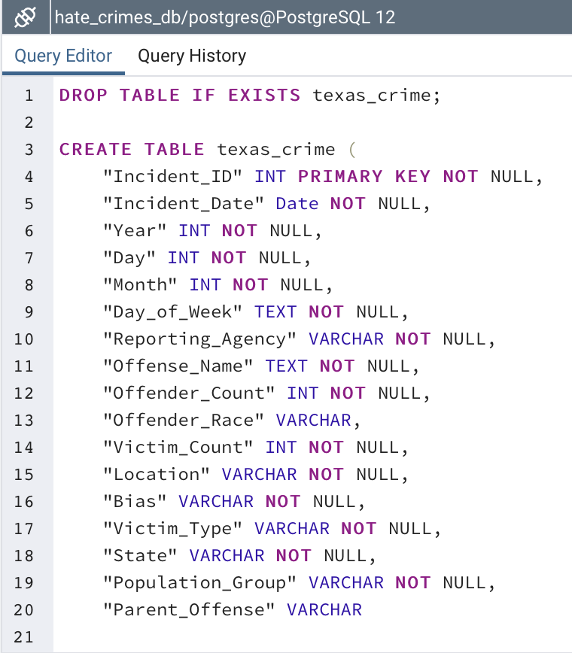
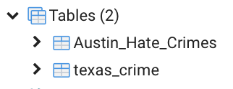
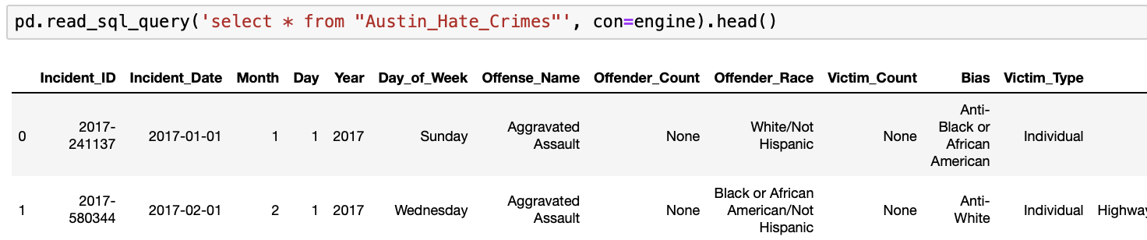
Load | Dataframes to PostgreSQL
Connection: Jupyter Notebook to pgAdmin using SQLAlchemy
Queries.sql file: For table creation in pgAdmin
Database: hate_crimes_db
Tables: Austin_Hate_Crimes and texas_crime
Display: SQL command in jupyter notebook to allow for further queries
Notes:
Wendy

Slide 5
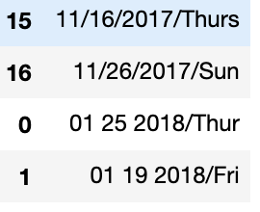
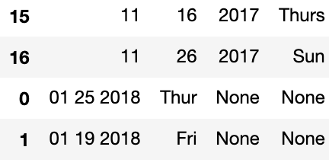
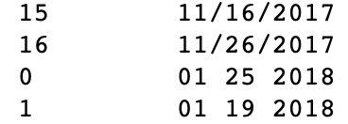
What We Learned
Format Date
Merge / Concatenate
.split / .rpartition
Notes:
Abby

